Slide 1
Robot Project Meeting 15 – 08/05/2019
Bourgogne, Colrat, Evaux, Gaizi, Nicolle – ACE TEAM
Chenaud - PTE

Slide 2
Agenda
Mode 3: the CNN sends the position of the numbers to the robot, the robot saves the position of the numbers and can go to each of them
At the moment: CNN sends the relative position and the robot goes to it
PCB design improved and sent to printing by Virgile
New GUI similar to the old one for modes 1 & 2, and an interactive map for mode 3.

Slide 3
Virgile, GUI & PCB design
Done:
Schematic done with modification for emergency stop button
PCB layout design done & sent to be printed
To do:
Mount the components on the board and test the board
Finish the GUI on Qt

Slide 4
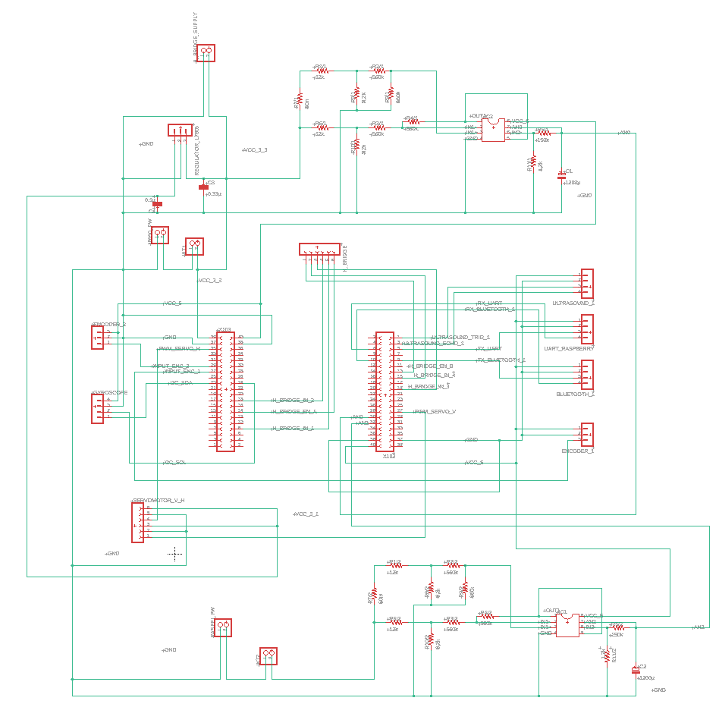
Schematic

Slide 5
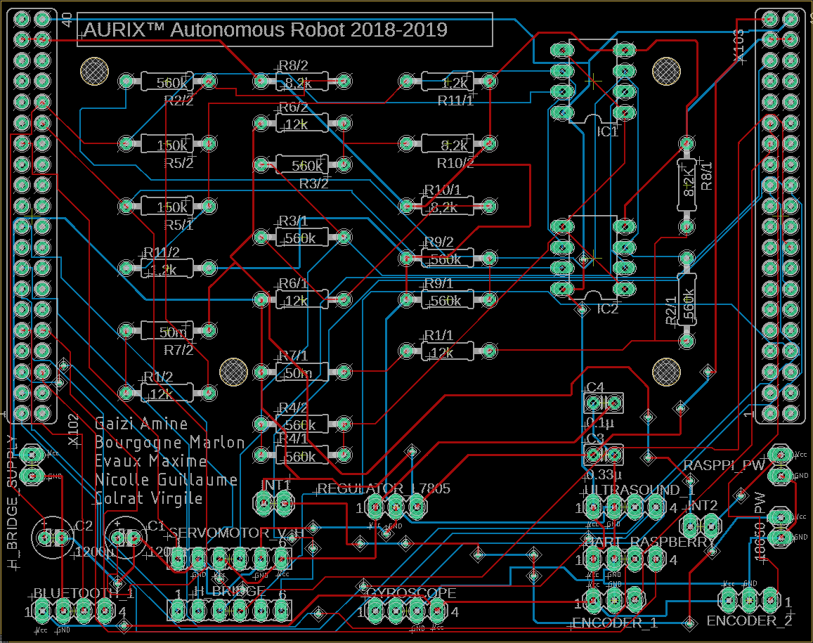
Board design

Slide 6
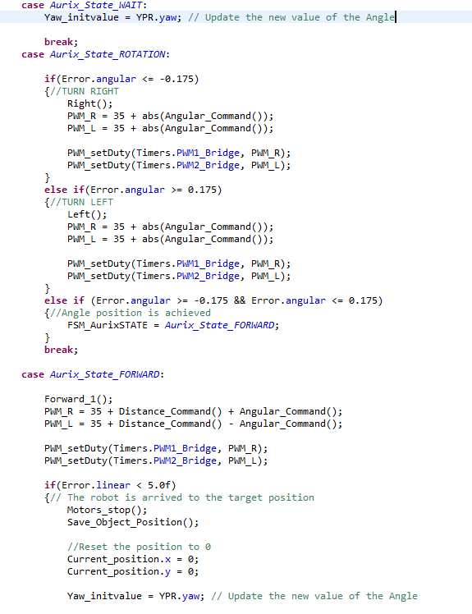
Amine: Enslavement for Mode 3
We give the robot the coordinates of a position, and it goes directly to it with a slight margin of error, the position and the error are calculated in real time
if at the beginning: |Angular Error| > 10, turn
H-Bridge set to go Forward, the PWM duty cycle depends on the linear and angular error, the constant value 35 works as a simplified Integrale correction (minimum value for the motors to make the robot move)

Slide 7
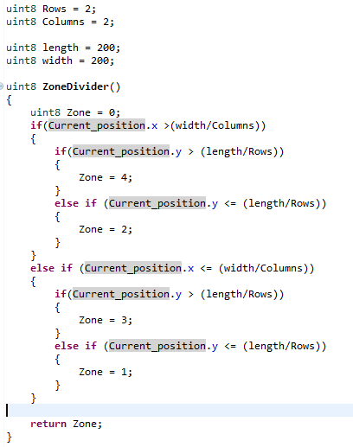
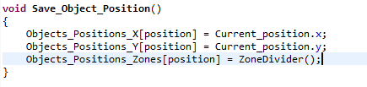
Amine: Enslavement for Mode 3
(X,Y) coordinates of the detected numbers are saved in an array
The map is divided in zones depending on its width and height. We can choose the number of rows and columns. Depending on the detected position of the numbers, a number is assigned a zone.
Y axis
Zone 4
Zone 3
length
Zone 1
Zone 2
width
X axis

Slide 8
Amine: Enslavement for Mode 3
Problems:
We are running out of memory space, if i add one variable, I fall in bus trap errors
Work in progress:
Mode switcher, having modes 1, 2 and 3 in the same project. Control them via GUI or AndroidApp instructions.
To-Do:
Reliable algorithm to go through the whole map at the beginning.
Goal: to detect the position of every number and assign them a zone.
When trying to go through the numbers one by one in order, the robot should go to the specified zone so the camera can detect it again. Then the robot follows the latest position sent by the CNN.
Find the dimensions of the map using the ultrasonic sensor, and make a more generic Zone divider.

Slide 9
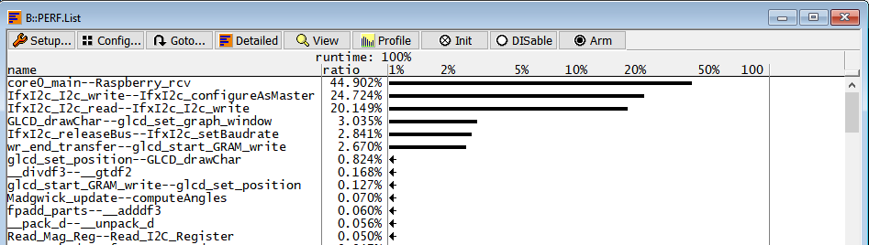
Amine: Enslavement for Mode 3
Analyze with Mayeul using AURIX profiler to see which functions are the heaviest to process for Cpu0
Meeting the afternoon with Kajetan Nürnberger to make a more detailed analysis on Cpu load and memory management

